Slide 1

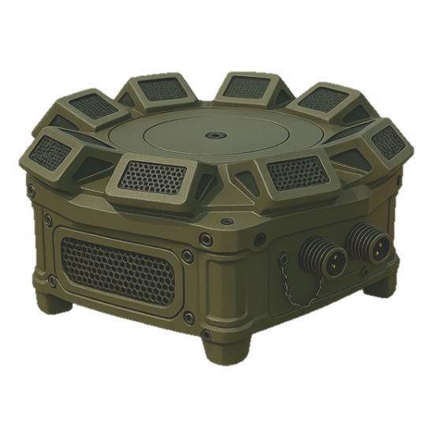
Acoustic
Aerial Threat Detection
Team 110
Matan Elad Guy Regev

Slide 2
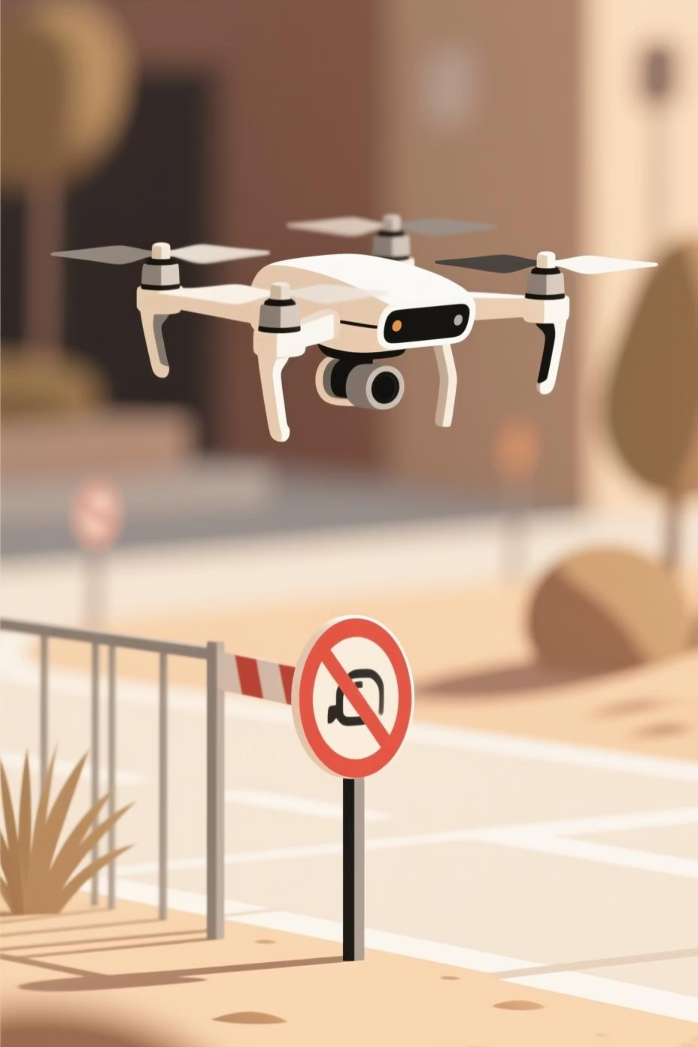
Chapter 1
The Problem:
Unseen Threats
The Poor Man’s Air Force
Hidden in Plain Sky
The drones' small size and flight characteristics hinder detection by traditional methods.
Low-cost, accessible drones pose growing security risks.
Detection at a Price
No Place Is Safe
Traditional methods are costly, complex, large, and immobile, with limited success against small drones.
Even military, government, and civilian sites remain vulnerable to drone-based threats.

Slide 3
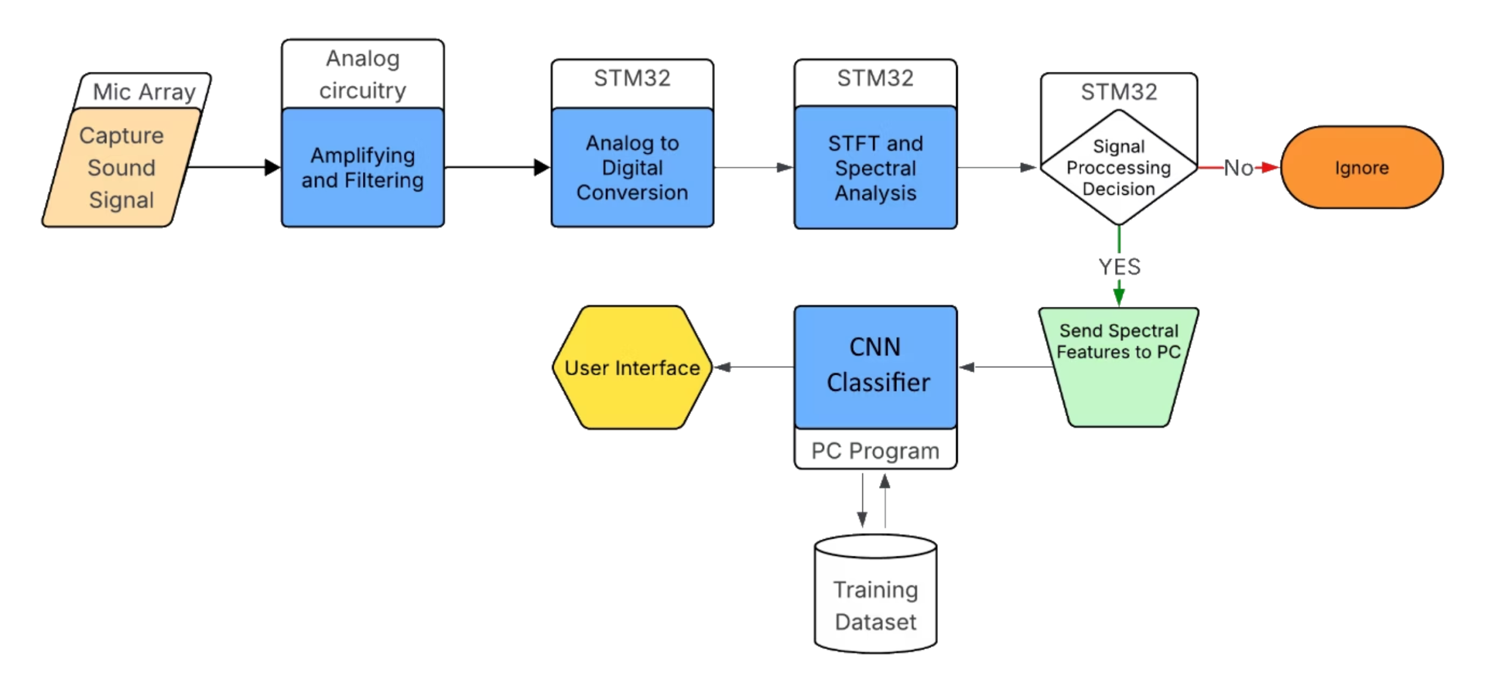
Chapter 2
The Solution: Intelligent Audio Analysis
Our solution combines cutting-edge deep learning with traditional DSP for robust acoustic drone detection.

Slide 4
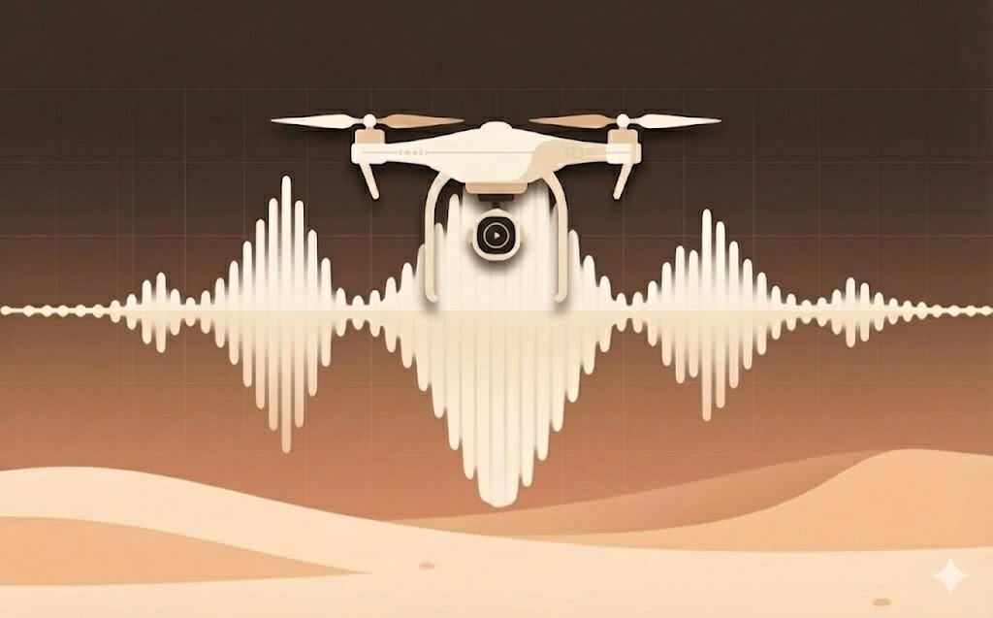

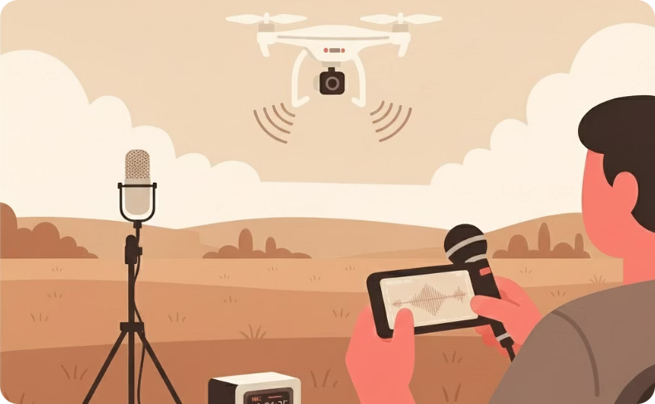
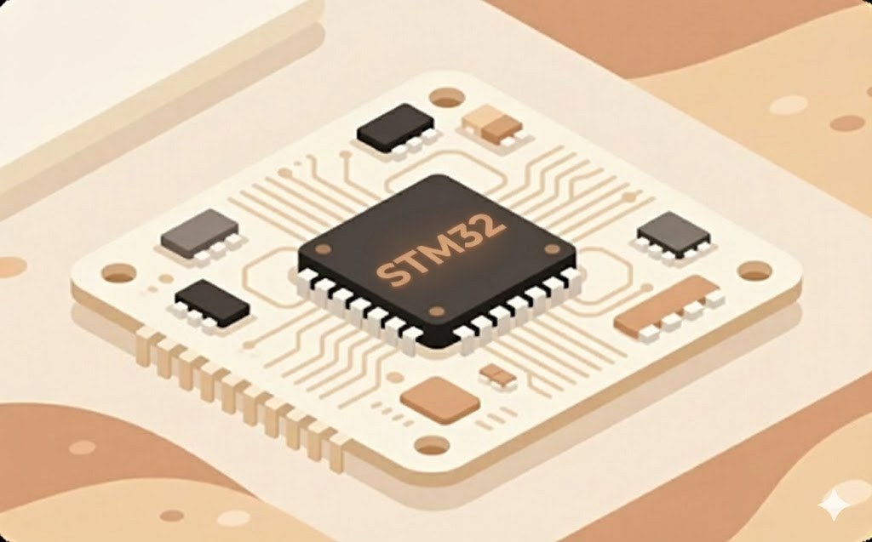
Chapter 3
Work Done Until Today: Foundation Laid
DSP infrastructure
CNN Model Development
Training Dataset
Hardware Testing
We implemented the core DSP infrastructure, including spectral analysis and feature extraction.
We are in the proccess of recording and labeling a comperhensive drone acoustics dataset.
Acquirement and initial testing of the microphones, microcontroller, and hardware constraints.
We implemented the backbone of the CNN classifier and training infrastructure.

Slide 5
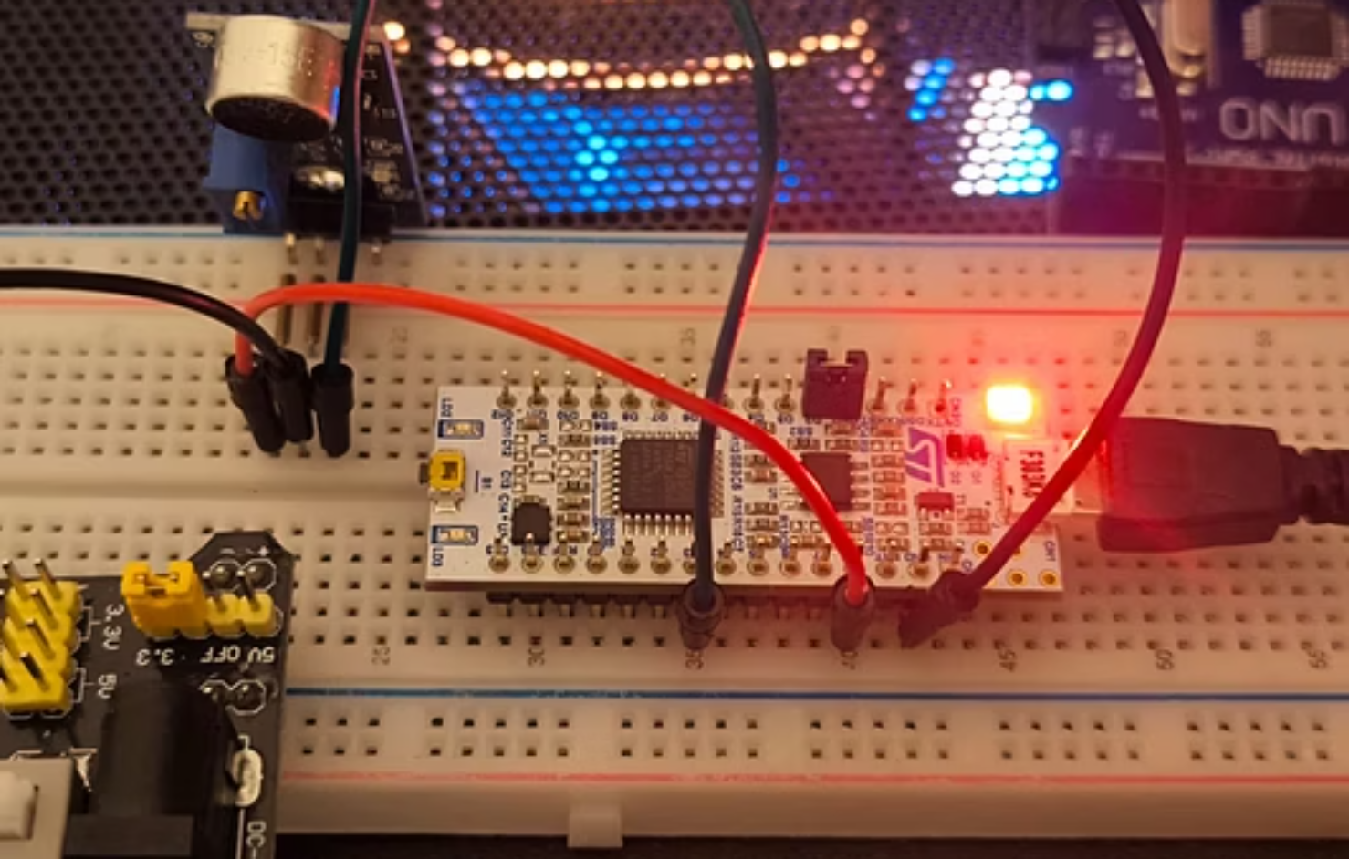
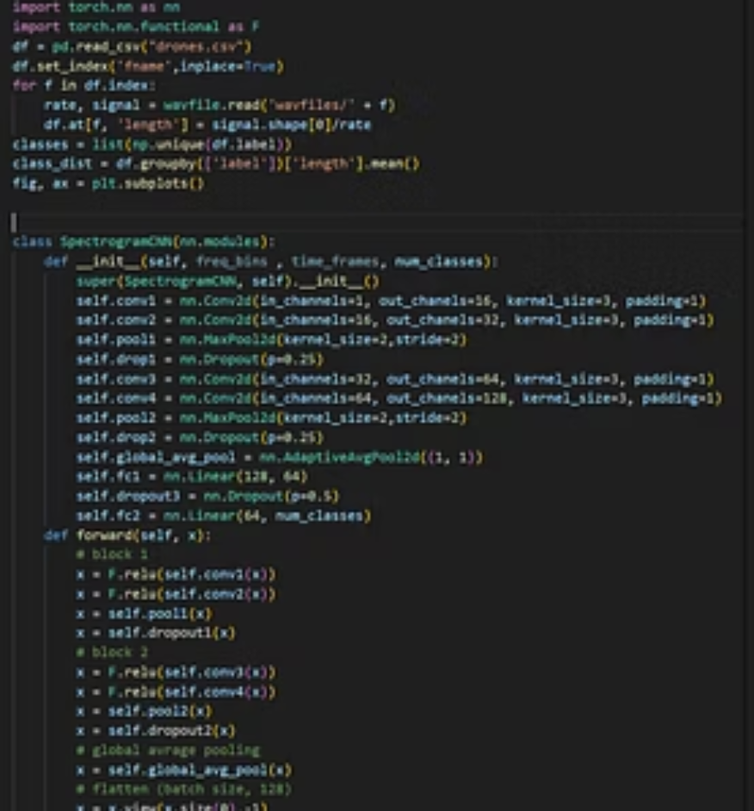
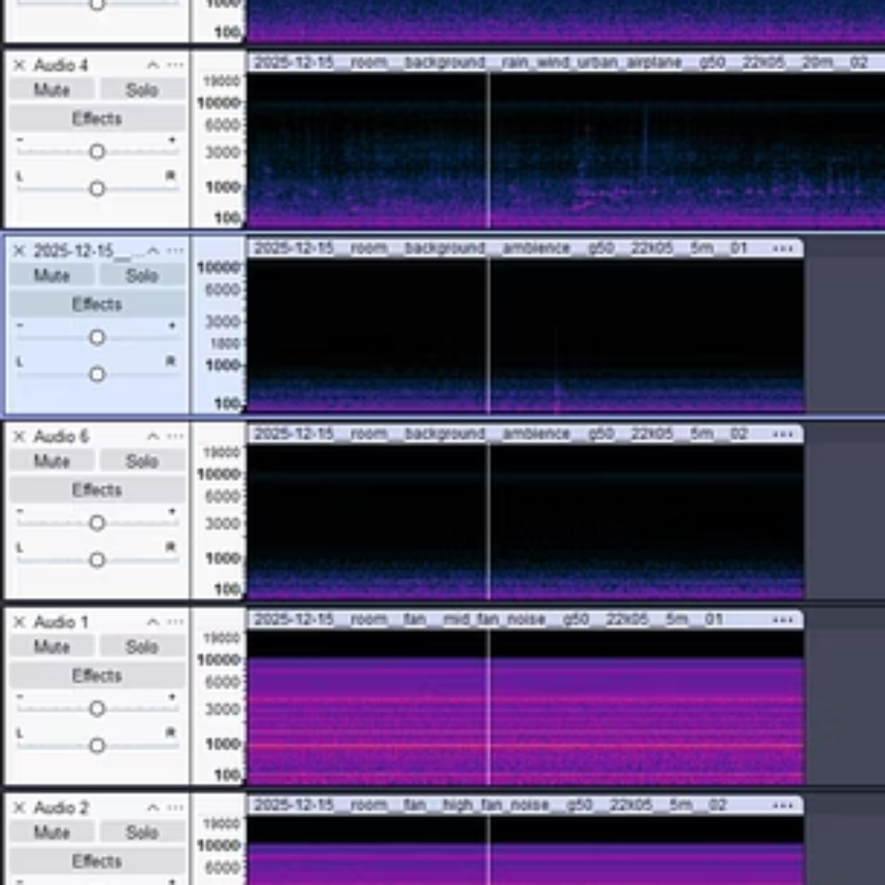
Initial Results

Slide 6
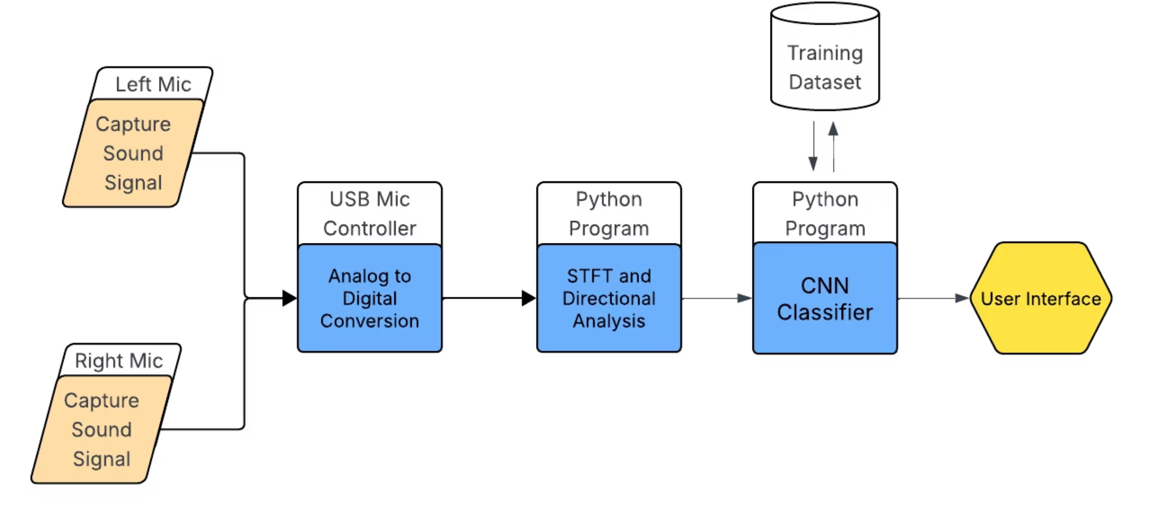
Chapter 4
Minimum Viable Product (MVP)
In our MVP we focus on:
CNN classifier
Limited directionality proof-of-concept
Simple and intuitive user interface

Slide 7




Chapter 5
Remaining Tasks
Training Data Recording and Labeling
Finalize the acquirement of acoustic data with enough variation to train the model.
CNN Model Training and Refinement
Train the model on the dataset, optimize hyper-parameters and model structure.
System Integration & Testing
Combine all the components and do extensive field testing, using the test data.
Embed User Interface
Implement the user interface and embed it within the finished system.

